Slide 1





INTERNSHIP AT ALTEN SO
R&D : Urgency in the Digital Twin Smart Green Supply Chain
Measuring declared against real urgency in a supply chain digital twin to acted upon
HOARAU John
Cohort 2026 DED
COMPANY
PERIOD
TUTORS
ALTEN Sud-Ouest
13 April → 16 October 2026
S. Perthuisot and F. Jules, ALTEN
Direction de l’Innovation · Lab de Toulouse
Confidential: YES
Dr. D. Gomez, ESTIA · Dr. P. Sherar, Cranfield
Notes:
(Name, Intership, ALTEN SO, DIN , TLSE)
1 number to open
8 turns before a satellite manufacturer missed its delivery commitment, the tool I built had already flagged it.
At that moment, its own manager was declaring an urgency near inexistent
Flagging, mesuring, forecasting that gap is what this mission is realy about

Slide 2







PLAN
1
CONTEXT, PROBLEM, MISSION
2
HOW THE PROJECT WAS RUN
3
LITERATURE, DESIGN AND REALISATION
4
RESULTS AND VALIDATION
5
ASSESSMENT AND PERSPECTIVES
Notes:
This prez will be in 5 parts !
The first three build the instrument.
The 4 is where the number I just gave you comes from.
The 5 is what I would do next.

Slide 3




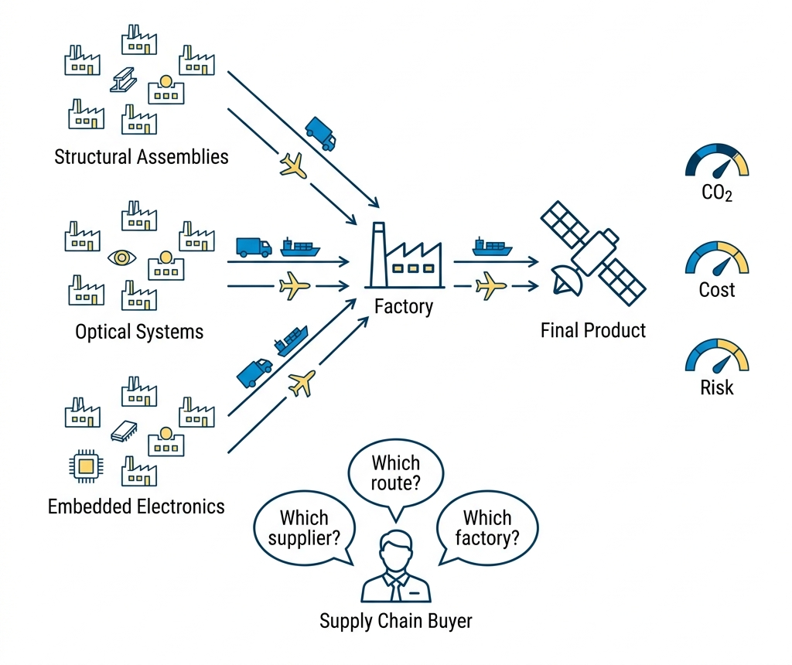




THE COMPANY AND THE PROGRAMME
ALTEN · Direction de l’Innovation · Toulouse Lab
1988
+30
11
31 %
FOUNDED
COUNTRIES
ALTEN LABS
R&D ON ENVIRONMENT
SMART GREEN SUPPLY CHAIN: THREE AIMS AT ONCE
LEAN
Cost, delay, excess stock
GREEN
Carbon per transport leg, to GLEC v3.2 and ISO 14083
PREDICTIVE
Anticipation of disruption.
DISCO, A serious game and a digital twin
Notes:
ALTEN Eng/Tech Consulting group.
Sell Eng expertise rather than product
Consulting grp work for many clients, they see the redudency in the diffuculty companys are facing
That how problem gets recognised as belonging to the industry rather than to a customer.
The program SGSC aim to unite Lean,Green,Predictive in a DT. My work sit in the 3rd one
Its central artefact is DISCO, a serious game and digital twin covering twenty-two suppliers.
Earlier internships built the routing, the risk scoring, the carbon and the transport
Not one of them computes urgency.

Slide 4





THE PROBLEM
THE TWIN HAS
THE TWIN NEVER SEES
Computed physical state
The human who decides
RESEARCH QUESTION
Can the gap between declared and computed urgency be measured reliably enough, inside a working digital twin, to be acted upon?
It must say which node is mismanaged
It must be reliable and explainable
It must beat the raw indicators a coordinator already has
Notes:
A coordinator opens the week with a list of nodes and a finite amount of attention
Somewhere on that list is the supplier that will cause next month's line stoppage. Nothing on the screen says which one it is. Thats what we try to figure out and avoid, -> where we should put more time to avoid catastrophic events.
The twin computes the physical state of every node. What it never sees is the human who decides.
A buyer says a supplier is critical, a plant says a line is at risk, and the twin records the consequence of those judgments without ever evaluating them.
Littérature showed across five controlled experiments that people favour imminent low-value tasks over distant high-value ones, and that the bias survives being told about it.
A twin that swallows that declaration as ground truth inherits the bias.

Slide 5
PLAN
1
CONTEXT, PROBLEM, MISSION
2
HOW THE PROJECT WAS RUN
3
LITERATURE, DESIGN AND REALISATION
4
RESULTS AND VALIDATION
5
ASSESSMENT AND PERSPECTIVES
Notes:
This prez will be in 5 parts !
The first three build the instrument.
The 4 is where the number I just gave you comes from.
The 5 is what I would do next.

Slide 6




THE WEEK
V-cycle for the model · Agile and Test and Learn for the week
MON
TUE
WED
THU
FRI
Planning
Scrum
Programme director
Scrum
Demonstration
The week’s objective
Blockages surface in a day
Scientific decisions
Course correction
Shown
TEST AND LEARN MEANS SOMETHING ONLY IF THINGS WERE LEARNED WHILE FAILING
The first urgency model, and why it could not fit
A single time-driven curve: urgency rose only as a deadline approached
It could not represent a node on time but out of capacity
It discarded indicators the twin already held
Notes:
The internship agreement prescribes Agile and Test and Learn, and I applied it literally.
The V-cycle runs on the model. Agile and Test and Learn run the week.
Five standing meetings a week is heavy for research and development, and it was the most useful organisational feature of the internship.
The Friday demonstration required something to be shown, making sure that project is evolving.
Test and Learn means something only if things were dropped and that i devlopped knowledge
The first urgency model was a single time-driven curve that rose as a deadline approached. It could not represent a node on schedule but out of capacity
I dropped it in April, at a cost of three weeks.
I gain knowledge and expericen in suplly chain organization, digital twin modeling and AI as i experienced all of them.

Slide 7
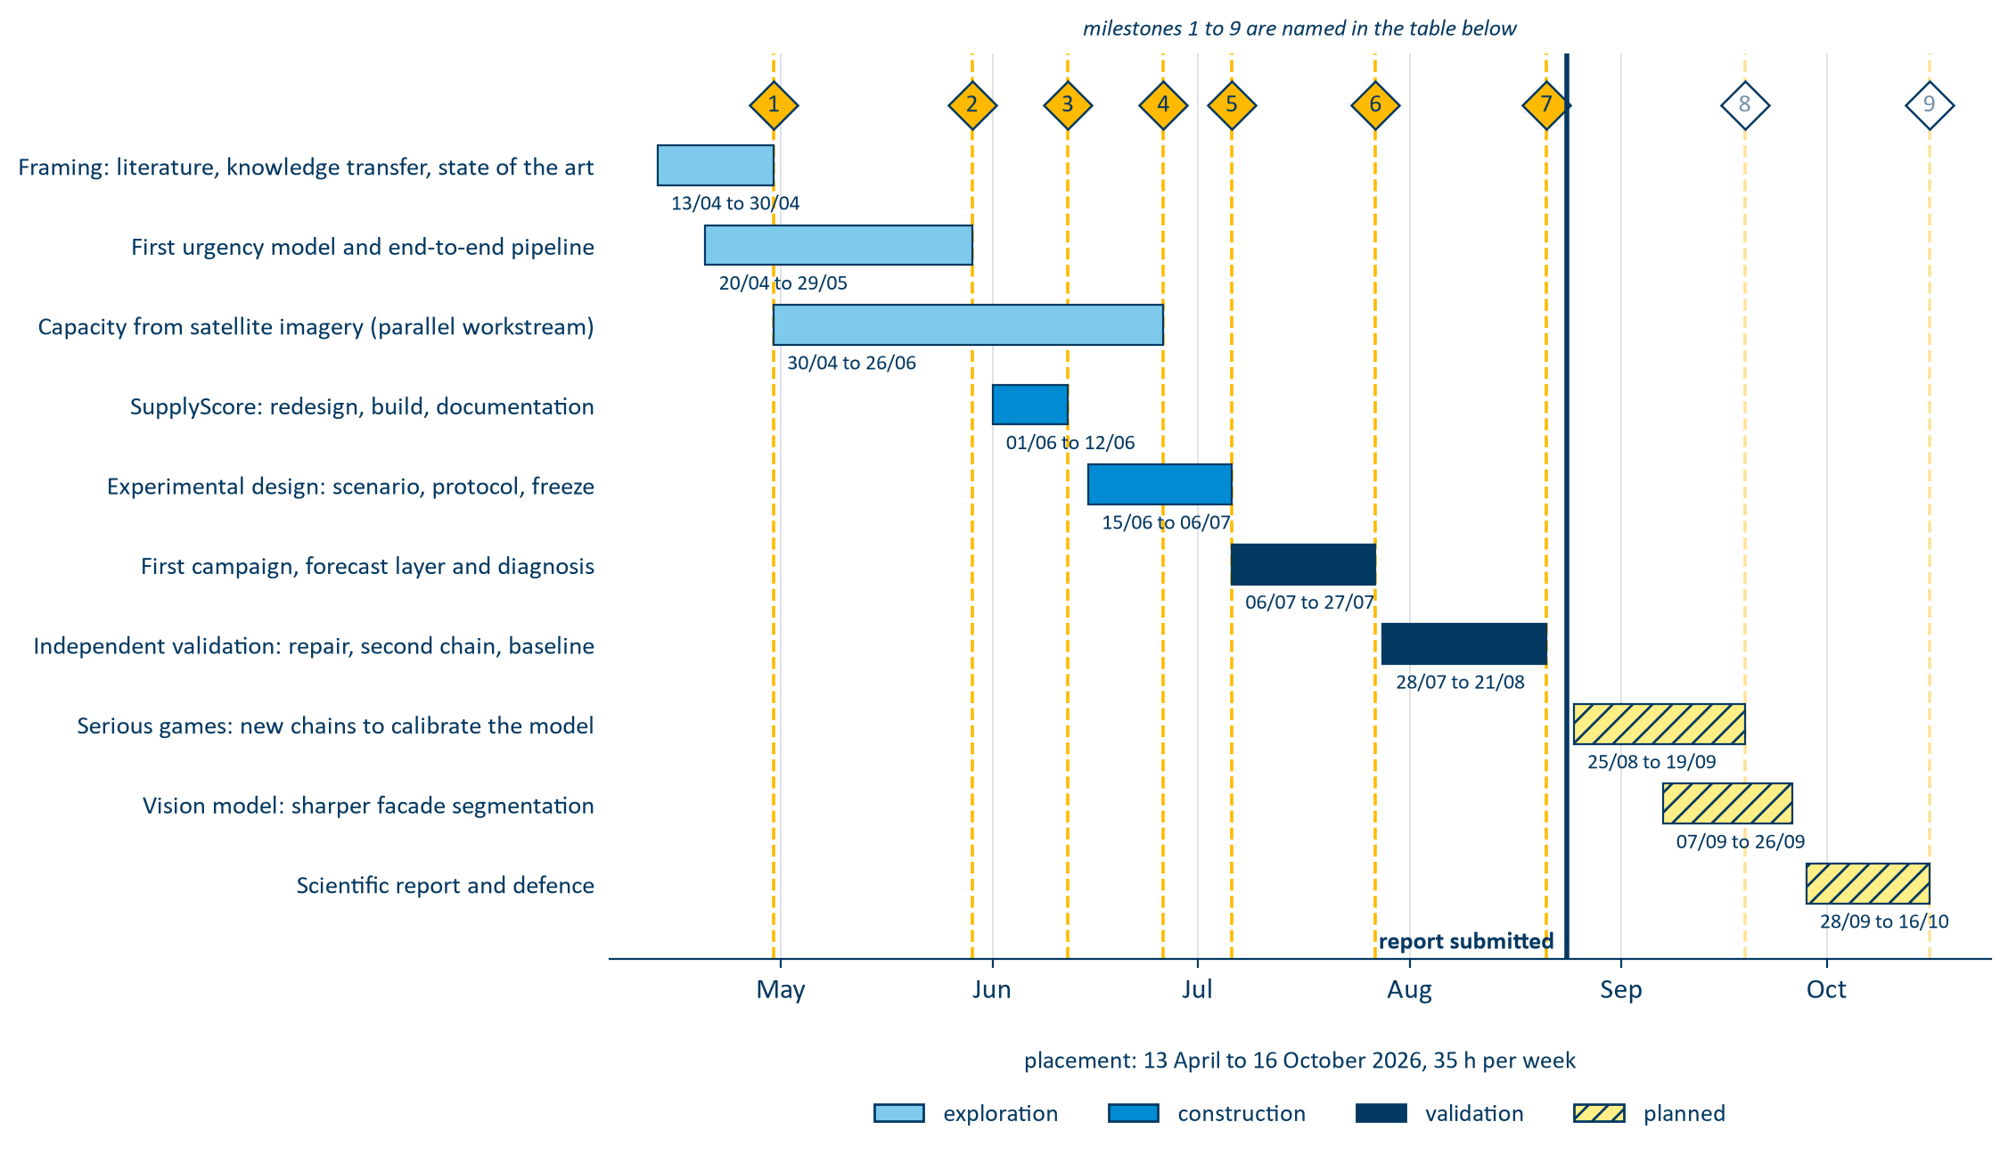
PHASES AND MILESTONES
10 phases · 9 milestones
Notes:
Ten phases, nine milestones, seven closed at the time of writing
One decision matters more than the rest. The original plan gave the second half of the mission to extending the model's scope. I reallocated it to validating what already existed.
An unvalidated extension of an unvalidated model compounds the problem rather than advancing it. That is why I can state a measured result today
Everything to the right of that line is planned, not done.

Slide 8
PLAN
1
CONTEXT, PROBLEM, MISSION
2
HOW THE PROJECT WAS RUN
3
LITERATURE, DESIGN AND REALISATION
4
RESULTS AND VALIDATION
5
ASSESSMENT AND PERSPECTIVES
Notes:
This prez will be in 5 parts !
The first three build the instrument.
The 4 is where the number I just gave you comes from.
The 5 is what I would do next.

Slide 9






LITTERATURE REVIEW GAP
What is new ?
PUBLISHED RESEARCH
THE PATENT RECORD: THREE LINES
Deadline-driven value. Time-varying, but one task only.
IBM. Revenue at risk from measured inputs. No operator opinion anywhere in the claims.
Ripple effect. Propagates, but takes the node score as given.
Wipro. Inputs replaced by language. The human narrates; nothing evaluates the narration.
Rupture indicators. Monitored one at a time, never combined.
Digital twin control tower. Oriented to automation. The operator receives decisions.
Cognitive bias. Quantified in the lab, no operational correction.
AHP, BWM, PROMETHEE. Static, and never compared to a computed value.
Fifteen years running away from the human declarant.
Digital twins. Scored on state; their inputs are assumed to arrive.
THE GAP
No system, published or patented, combines a declared urgency, a computed one, and their propagated mismatch. To achive a forcast.
Notes:
I looked in two places.
Six streams, and each one settles something and leaves something open.
Read the second half of each line and you have my specification.
The patent record was more interesting.
IBM, 2007: computed entirely from measured inputs.
Wipro, 2019: those inputs are replaced by language, so the human narrates but is never assessed.
The most recent is a control tower where the operator receives decisions.
Fifteen years running away from the human declarant.
So the gap is specific. No system, published or patented, elicits a declared urgency, computes its counterpart on the same node, and scores the difference against recorded outcomes

Slide 10
OBJECTIVES AND INDICATORS
OBJECTIVE
INDICATOR
O1
Define real/declared urgency and the adequacy score
Every term decomposable; aggregation justified
O2
Propagate across tiers, rank by criticality
Real-programme scale, interactive time budget
O3
Deliver a working, auditable application
Every write logged, tests passing
O4
Establish whether the signal predicts outcomes
Serious game testing
O5
Global warehouse capacity imagery modeling
KPIs
Notes:
5 objectives
I flag the fourth now, because it changed the shape of the mission.
Its test runs inside the serious game, against a baseline
Holding to that clause turned a validation step into the main contribution.

Slide 11

THE MISSION
A working application, two independently elicited signals, and the score that compares them
DECLARED U_{D}
COMPUTED U_{R}
AHP, FUZZY BWM AND PROMETHEE II
WEIGHTED PROBABILISTIC OR AGREGATION METHOD
Operational impact
↔
Performance and capacity
Time window
↔
Time, against the next deadline
Downstream dependencies
↔
Severity propagated across tiers
Recoverability
↔
Risk, through its recovery term
No declared counterpart
↔
Cost and carbon, arbitration only
ADEQUACY SCORE
The distance between the two signals, on a 0–100 scale.
False urgency · declared > state · penalty ×1
Hidden risk · state > declared · penalty ×2
Every term stays recoverable, so the operator sees what moved the answer.
Notes:
LEFT , declared urgency: Each node the operator compares 4 criteria pairwise, which yields to a consistency-checked method for each criterion
On the RIGHT, computed urgency, from 6 indicator blocks.
They all have contrepart so they can be compared together
Just Cost and C02 haven’t as they are arbitrate.
The 1st part of the internship has to make this to get the Adequacy score wich is the distance between the types of urgency, on a 0-100 scale, and it is made delibertely asymmetric.
False urgency costs one. Hidden risk costs twice as much.
That is the rule clinical triage has applied for decades: under-triage costs a life where over-triage costs a queue. We mimic this here.

Slide 12



REAL URGENCY
Non-compensatory probalistic aggregation score
A node is in trouble if any one block fires. A healthy block cannot offset a failed one.
U_{r} = 1 − ∏_{m} (1 − u_{m})^{ω}_{m}
NODE A
NODE B
one block has failed
nothing has failed
The average sends the coordinator to Node B , where nothing broke. The OR sends them to Node A , where capacity did. Same six numbers, opposite ranking.
time
0.05
time
0.20
capacity
0.90
capacity
0.20
performance
0.05
performance
0.20
risk
0.05
risk
0.20
FOUR CAUSES · TWO CONSTRAINTS
cost
0.05
cost
0.20
carbon
0.05
carbon
0.20
Time
Capacity
Performance
average
0.19 → 2nd
average
0.20 → 1st
probabilistic OR
0.92 → 1st
probabilistic OR
0.74 → 2nd
Risk
Cost
Carbon
Notes:
A moment on the aggregation method, because it is the central modelling decision
Its a non compensatory probalistic aggregation score ; Wich mean that each block are independently able to exitate the score without masking other values !
It is calculate as a probability, and it is 1- probability that none of them fires.
In the littérature this aggrgation methode are called OR like the logical connective.
See here we have 2 nodes, A & B. If we have to organize them into wich one need the most attentions, we can use the classical averge or a proablistic OR. The probalistic OR fits the best.

Slide 13
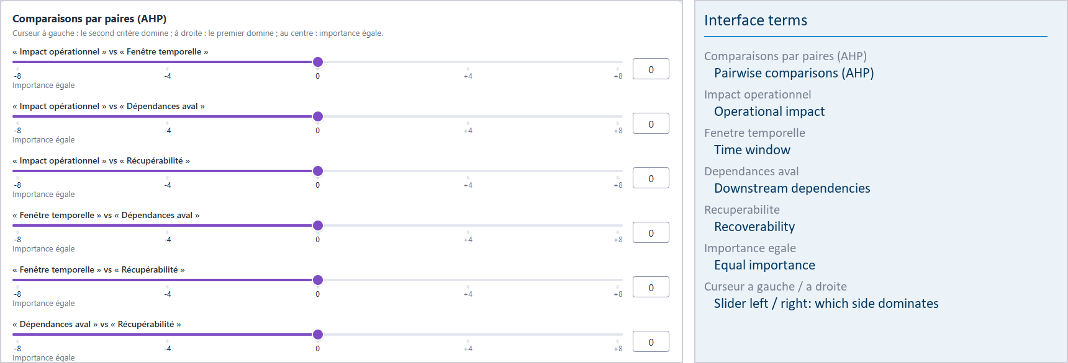
DECLARED URGENCY
Elicited from the operator, gated on consistency, then propagated downstream
THE CONSISTENCY GATE
A weight vector whose consistency ratio exceeds the threshold is refused . The operator is sent back to the most contradictory of their own comparisons.
Without it, an incoherent judgment would propagate as though it were a considered one.
The application is operated by a French research programme, so its interface is French. The report carries an English key for every term on screen.
FOUR CRITERIA, EACH WITH A COMPUTED COUNTERPART
Pairwise comparisons, not a free-text estimate
Operational impact
Time window
AHP · fuzzy BWM · PROMETHEE II
Downstream dependencies
Recoverability
Notes:
Declared urgency is an estimations but we have tried to get the most out of it. We use multiple methods to calibrate the tools for the 4 criteria conterpart.
Then we used Analytic Hyerachy Process method each week to have a new human data entry, where we ask the customer to fill a short form.
AHP allow us to check the consitency in the human declaration, so we can know if it is realiable or not. Otherwise we politely asked to review.

Slide 14
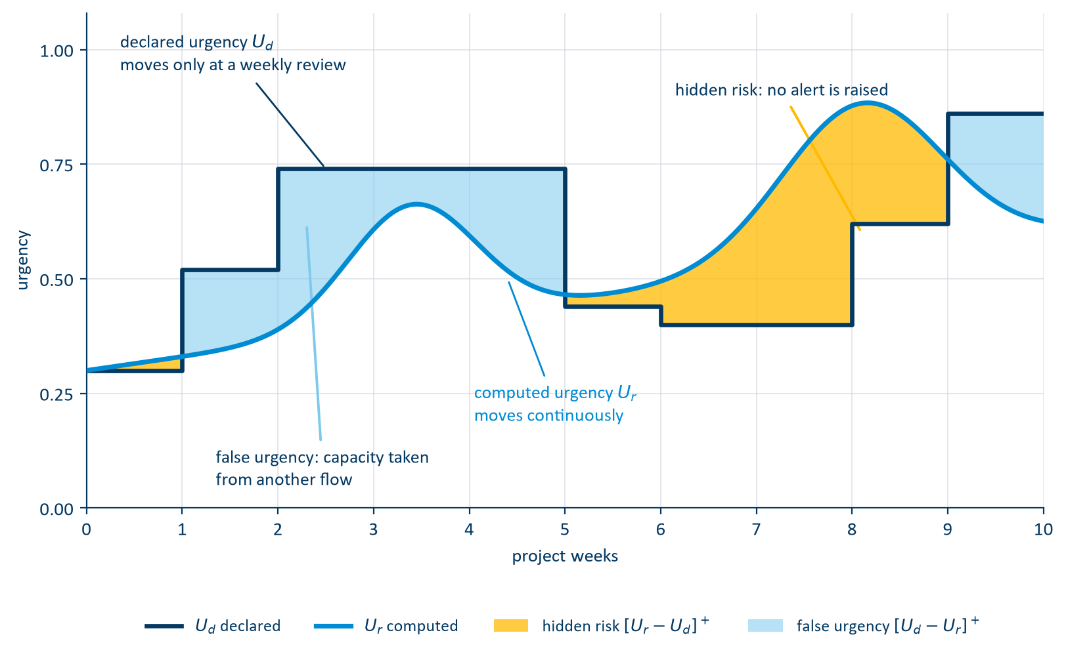
THE ADEQUACY
Elicited separately, propagated in opposite directions
PROPAGATION ACROSS THE NETWORK
γ
Customer · final assembly
Tier 1 · systems
Tier 2 · subassemblies
Tier 3 · raw material
β
γ attenuates the declaration as it descends: demand pressure is what a customer transmits
β amplifies computed risk as it ascends: physical risk is what a supplier transmits
Notes:
When we have both signals over the life of one task, we can manage to plot them, and see the mismatch.
The declaration is a staircase llok as it chnage only at each time a human give its signal.
Where the declaration is above the state, the operator is spending attention on a node that does not need it. Capacity taken from another flow. Its False Urgency
Where the state is above the declaration, nobody has raised an alert
That is hidden risk, and it what we are mostly looking for.
Also this signals propagate troughout the supply chain, in opposite directions. Gamma attenuates the declaration as it descends, beta amplifies computed risk as it ascends.
The asymmetry is physical: demand pressure is what a customer transmits, physical risk what a supplier transmits.

Slide 15
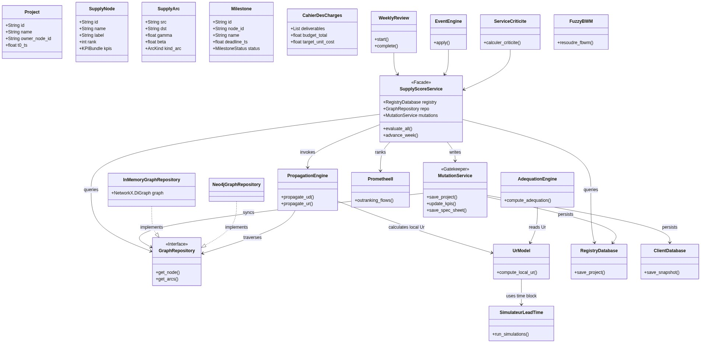
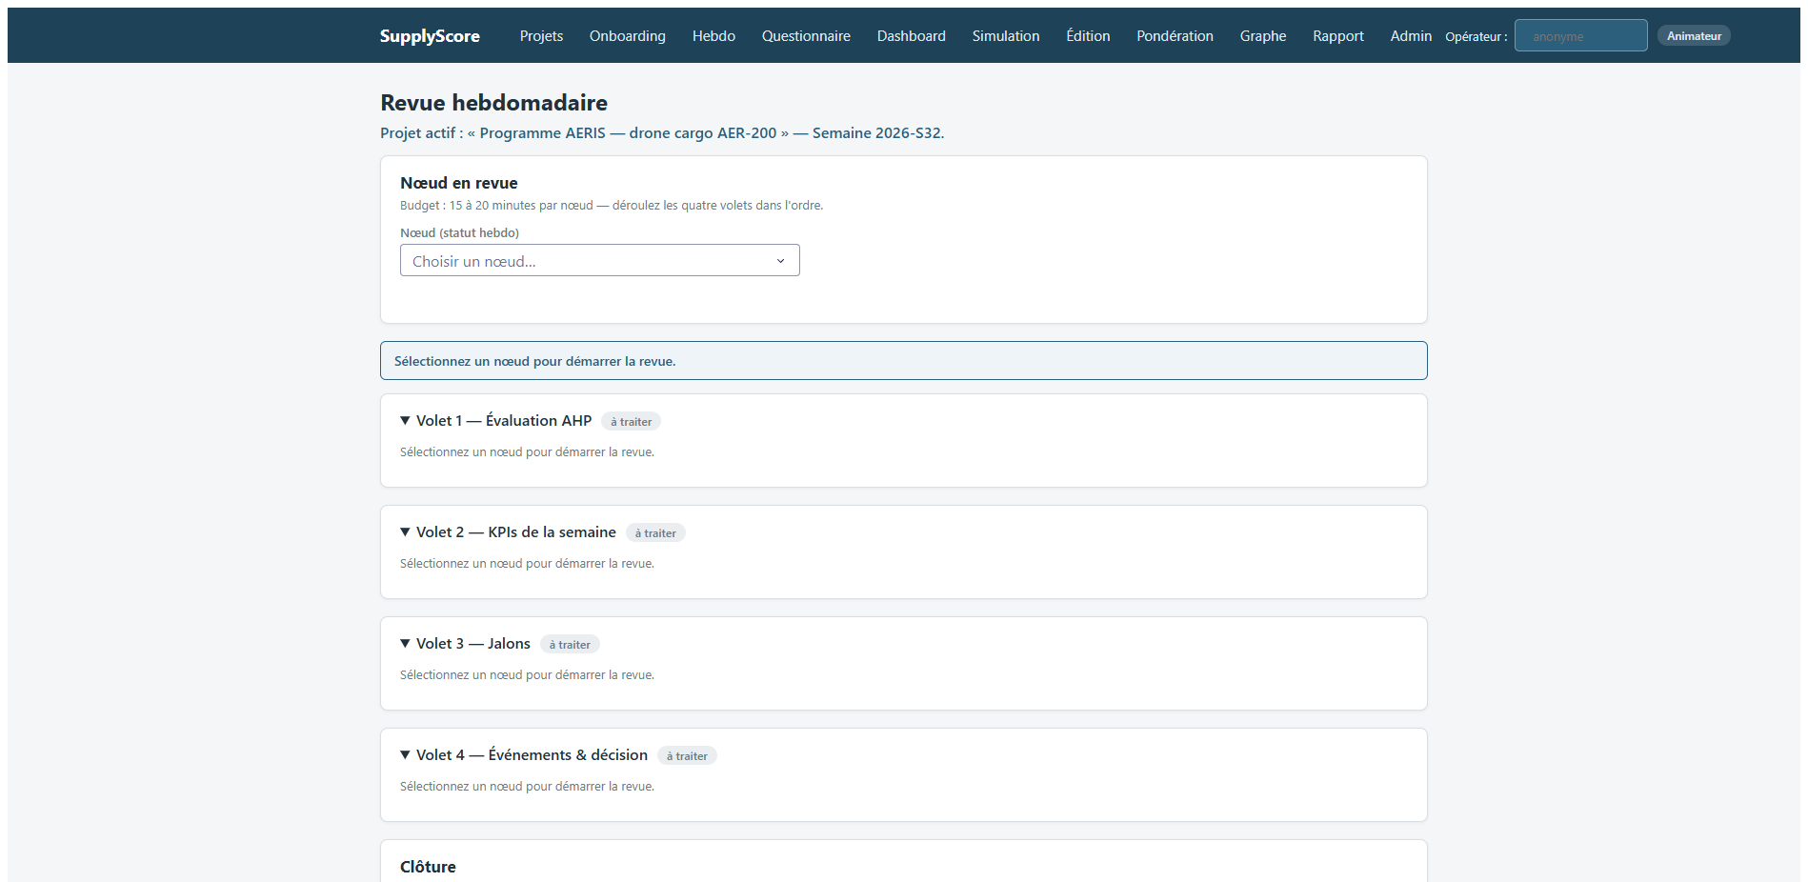
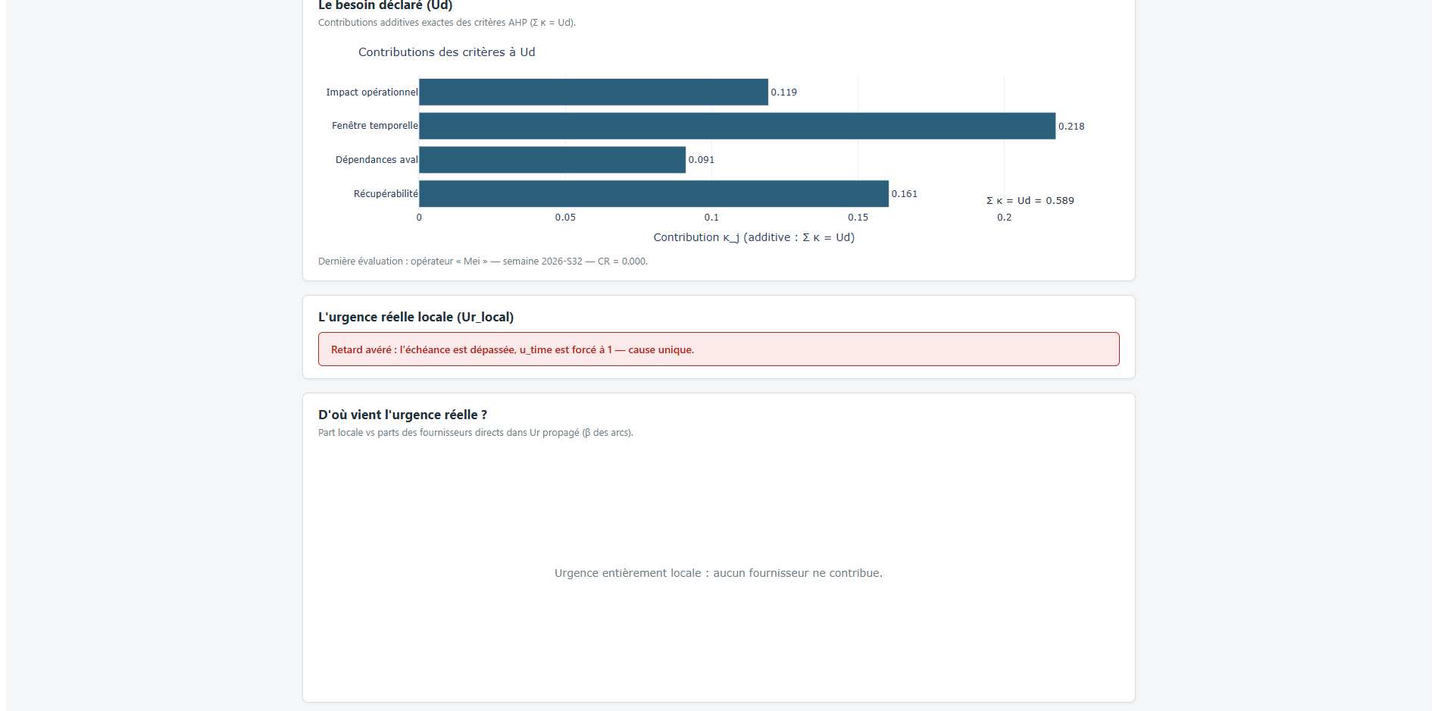
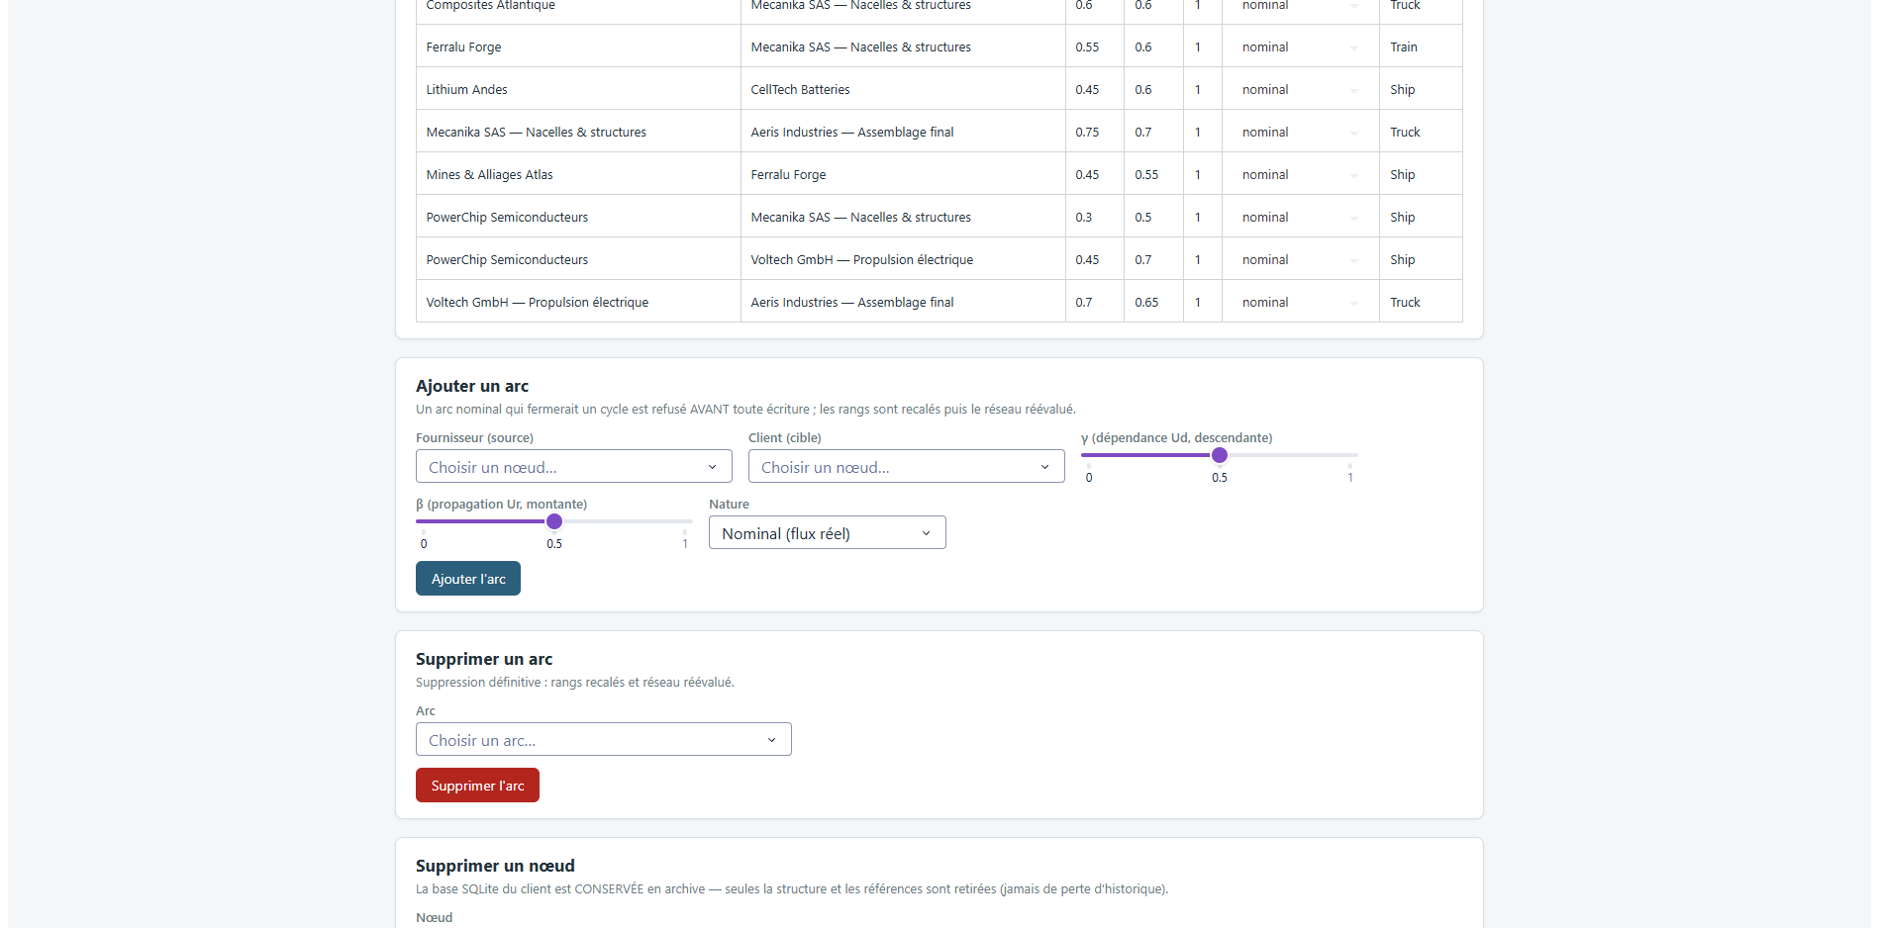
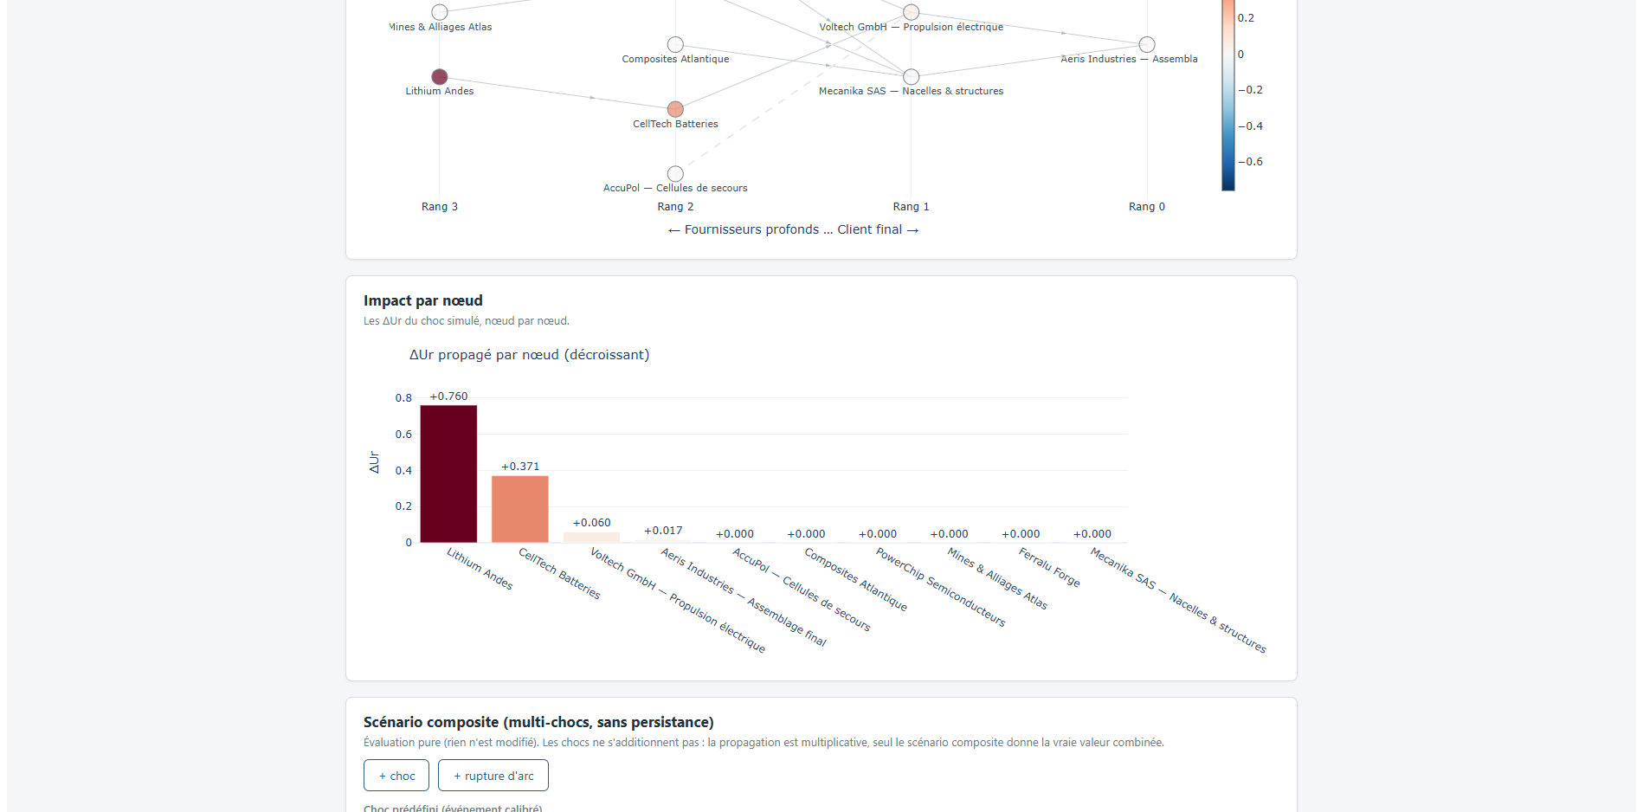
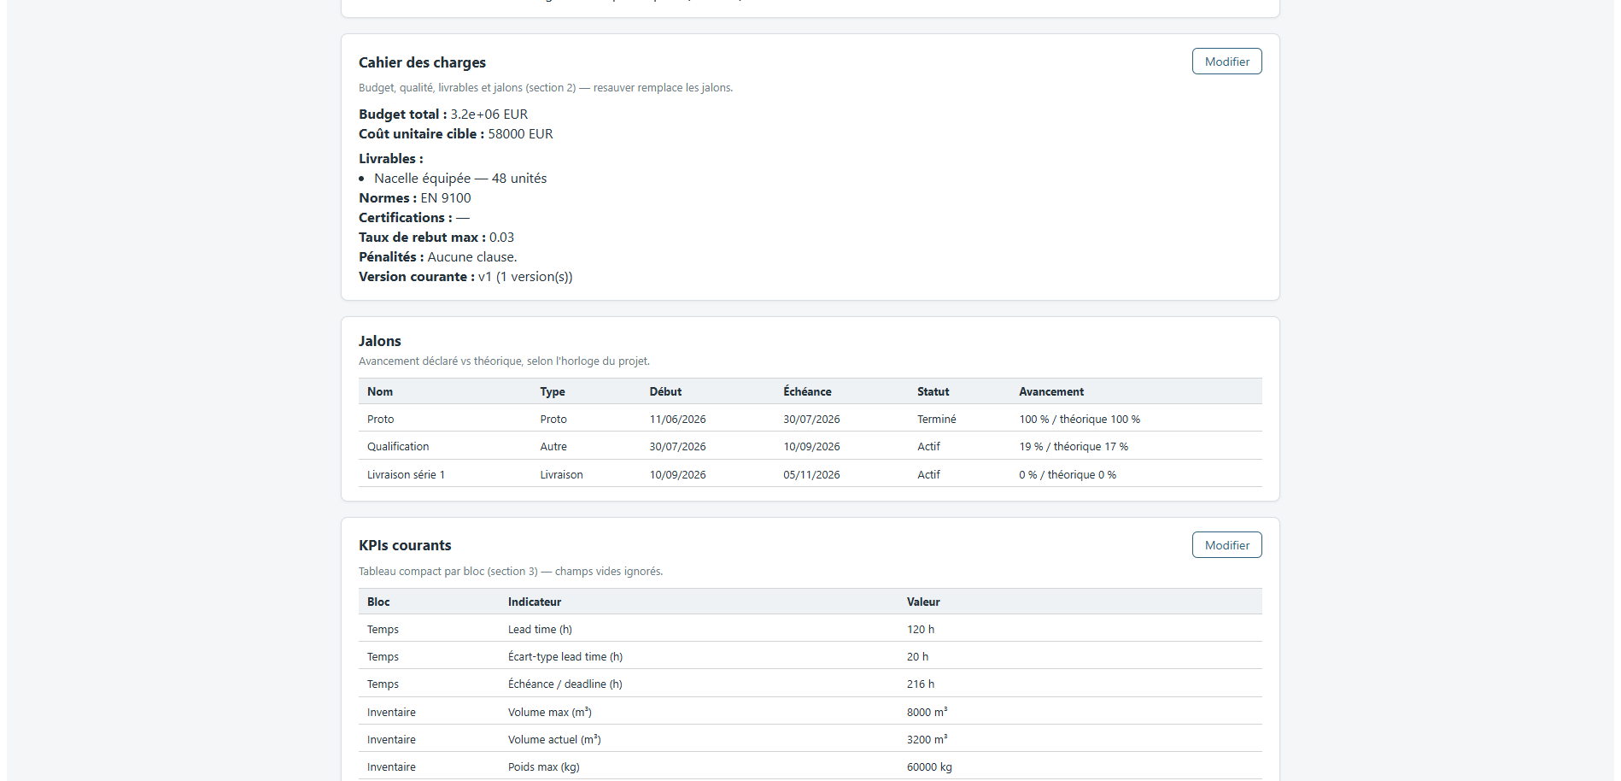
SUPPLYSCORE: ARCHITECTURE
The class model, and the pages it drives
THE CLASS MODEL
THE APPLICATION, AS THE OPERATOR MEETS IT
Weekly review · one signed transaction
Explainability · term by term
Network · generated per project
Criticality · each node knocked out
A NODE, AND WHAT IT CARRIES
Facade the only entry point
Mutation service the audit trail is architectural
One DB per node isolation by storage layout
Every arrow into the data crosses the facade, then the mutation service. Two graph repositories sit behind one interface, so the network can be held in memory or in Neo4j without the domain knowing which.
Notes:
You cannot read this diagram from where you are sitting, and you do not need to.
In the UML you can see that Every operation passes through a single orchestrating facade.
Every business write then crosses a single mutation service that validates ranges, diffs against current state, and records the author.
As the tool must be trusted even an audit part has been implmented inside the archtecture to trace evry decision keep logged and frozen
Also data persistence was a major aspect so we have made that each node have their own DB, to keep isolation.
On the right, the application as the operator meets it. A web interface, where he can manage and see whats happening uder the hood
The weekly review commits as one signed transaction. The explainability page reconstructs any score term by term
That explainability page is what made the next diagnosis possible from the application rather than by hand

Slide 16
PLAN
1
CONTEXT, PROBLEM, MISSION
2
HOW THE PROJECT WAS RUN
3
LITERATURE, DESIGN AND REALISATION
4
RESULTS AND VALIDATION
5
ASSESSMENT AND PERSPECTIVES
Notes:
This prez will be in 5 parts !
The first three build the instrument.
The 4 is where the number I just gave you comes from.
The 5 is what I would do next.

Slide 17

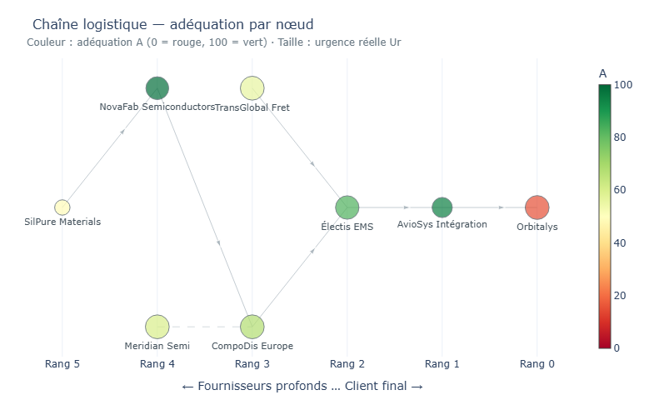
RESULT 1
Nodes ranked by hidden risk above 0.10, against the nodes that later missed
1.00
3 / 4
0
8
PRECISION, TURNS 0–5
FUTURE FAILURES FLAGGED
FALSE ALARMS IN SIX TURNS
TURNS OF ADVANCE WARNING
T0 – T5 · signal sharp
T6 – T18 · crisis public, the gap closes
The worst-scoring node is the satellite prime. Flagged from turn 0, it misses at turn 8.
THE DASHBOARD THE COORDINATOR READS
The flag comes from an optimistic declaration against a computed state that is not.
Early warning, not crisis management.
Notes:
Now the results. That iswhere the number i gave you came from.
We managed to replay the 2020 to 2022 semiconductor shortage to test and calibrate the tools.
Real urgency KPIs comes from public time series of the actual crisis, declared urgency from the LLM
What we have leraned is that the tool is able to give an early warning and detect clearly where its mismanged and where thers a mismatch
Where some AI manager was proudly saying that thers no shortage incoming, it was setting it up, but the tool manage to detect it.
But, as i thought, when the shortage is becoming from exogenous part the sgnal crumbles as weeks pass….
Even so this precision is an encouraging observation,

Slide 18
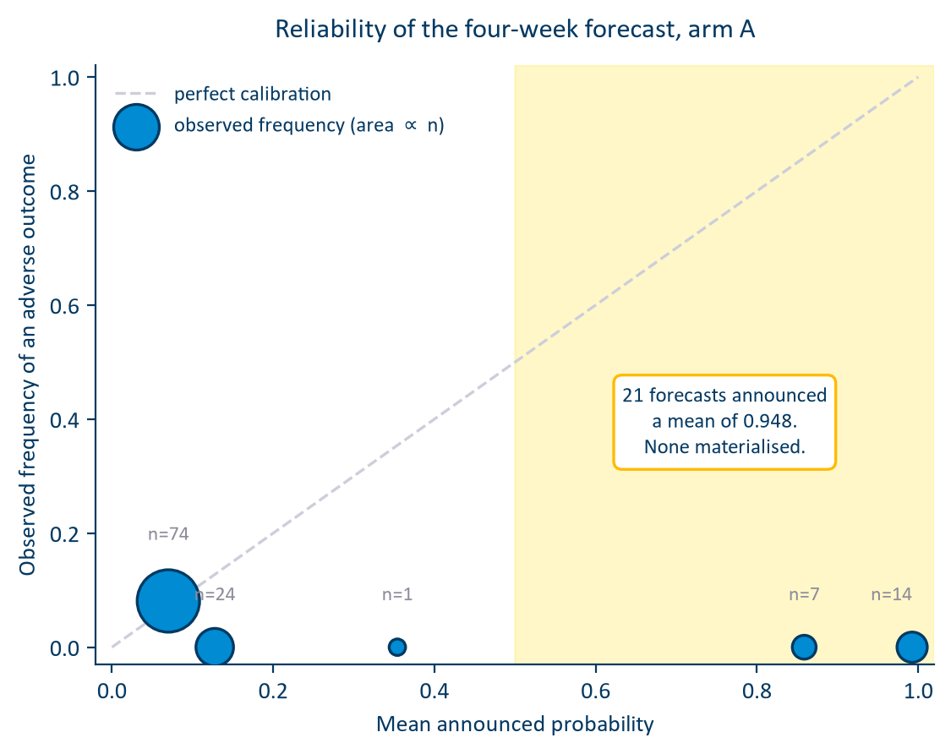
RESULT 2
Scored → Calibration → forcast → re-measured
BRIER SKILL, BEFORE → AFTER
HORIZON
before
structure
+ uncert.
1 week
−1.278
−0.646
−0.687
2 weeks
−0.690
−0.401
−0.367
3 weeks
−0.654
−0.360
−0.286
4 weeks
−0.553
−0.272
−0.216
The calibration deficit roughly halved at every horizon. AUC movement is not interpretable at this sample size : with twenty-six positives the four-week interval runs from 0.21 to 0.87.
Notes:
I try to get more of that signal and try to forcast the possiblity of the urgency using Monte Carlo simulatiton based on previous historic data of the crisis and compare them with the baseline of earlier.
In a short answer i did not managed to make it work… as it need way more calibration and validation. The result i got was near absolut chance, my Brier skill was even worse that the baseline itself… So bad forcast…. I wont became a good metorologist.
The reliability diagram localises it. Where the model announces a low probability, it is right.
Where it announces a high probability, it is wrong every time…
As we speak i am still working on tuning this method as i am maybe in piste to find out where the missing informations are hidden…
Also i am filling the missing infomations gap with syntethic meaning data as it is hard to find higly public data.

Slide 19
PLAN
1
CONTEXT, PROBLEM, MISSION
2
HOW THE PROJECT WAS RUN
3
LITERATURE, DESIGN AND REALISATION
4
RESULTS AND VALIDATION
5
ASSESSMENT AND PERSPECTIVES
Notes:
This prez will be in 5 parts !
The first three build the instrument.
The 4 is where the number I just gave you comes from.
The 5 is what I would do next.

Slide 20


OBJECTIVES VS. OUTCOMES
2 campaigns · 2 chains · 23 nodes · 33 milestones · 510 declarations
O1
Met
Six blocks, bidirectional propagation, asymmetric score — every term decomposable
O2
Met
SupplyScore delivered: multi-tenant, every write audited, tested, documented
O3
Met
Propagation and criticality operational; the saturation collapse found and repaired
O4
Met, domain established
Right at node level on chain 1; scored, located, repaired, re-measured; then bounded by chain 2 and the baseline
O5
Met, ongoing
Segmentation model is ongoing but show interesting reults
WHAT THE PROGRAMME CAN NOW SAY ABOUT THE INSTRUMENT
Detects misperception
An early-warning instrument that closes once a crisis is public
Its forecast buys calibration , not short-horizon discrimination
Notes:
Everything you have seen rests on this: 2 campaigns, 2 chains, 23 nodes, 33 milestones, 510 déclarations
objectives met What the programme can now say about SupplyScore comes down to three statements."
"It detects misperception."
"It is an early-warning."
"And its forecast layer buys calibration rather than short-horizon discrimination."

Slide 21


LIMITS · NEXT · WHAT I TAKE
Three limits of sample, one of method, and a list produced by measurement
LIMITS
FOR ALTEN, IN ORDER
THE LESSON I KEEP
Agents, not human consultants
1
Connect computed urgency to the forecast quantity.
Autonomous
AI
Problem modelling/solving
Methodologie
Small positive results
2
Collect more indicators before calibrating
ESTIA COMPETENCY FRAMEWORK
3
Make the forecast state its own ignorance; smooth the alarm
CI1
CI3
CI5
CE3
CE4
CE5
CST1
CST2
CST7
4
Run the campaign with humans, the only run that decides

Slide 22


THANK YOU
QUESTIONS
HOARAU John · Promotion 2026 ALTEN Sud-Ouest · Direction de l’Innovation · Lab de Toulouse 13 April → 16 October 2026

